Slide 1
Hypothesis Testing

Slide 2
Hypothesis
A hypothesis is a testable statement about something in the world around you.
It should be capable of being tested, either by experiment or observation.
Example :
A new medicine you think might work.
A way of teaching you think might be better.

Slide 3
Hypothesis
A hypothesis is statement made in support of a finding or a claim. This statement should to be tested for its statistical validity.
Examples of Hypothesis :
The new engine developed by R & D gives more mileage than existing engine.
It is suspected that a soft drink producer is under-filling the cans.
The Ah rating of batteries supplied by the sub-contractor is different from specified 12 hours.
It is natural that an odd engine, can or battery might have conformed to above statements and the analyst has to statistically prove that above finding or claim is supported by data.

Slide 4
Hypothesis Testing
Hypothesis testing in statistics is a way for you to test the results of a survey or experiment.
Hypothesis testing is an objective scientific method that is used in making statistical decisions using observational or experimental data.
Hypothesis Testing is basically
An assumption that we make about the population parameter.
A premise or claim that we want to test.
Example: Next Slide.

Slide 5
Hypothesis Testing Statement
Police department claims that the newly introduced traffic rules have substantially decreased deaths due to road accidents. Historically annual deaths due to road accidents have been 1234.
Statement
Number of accidents have decreased after the introduction of new traffic rules by the police.
Population Mean 1234.
Hypothesis Testing is basically
an assumption that we make about the population parameter. We assume that new population mean is different from 1234.
We want to analyze new data (sample) to validate the claim by police.

Slide 6
Types of Hypothesis : Null Hypothesis H₀
Null Hypothesis states that there is no real effect. What is observed is due to variation caused by uncontrolled variation inherent in the system. Null Hypothesis is denoted by H₀.
Example :
Special training on student has no effect.
Different teaching method has no effect on students’ performance
Drug used for headache has no effect after application.
In all the above statements, the null hypothesis assumes that perceived difference is due to natural variation in data.

Slide 7
Types of Hypothesis: Alternate Hypothesis H_{a}
Alternate hypothesis. This is the fact we are trying to prove.
Alternate hypothesis is denoted by H_{a.}
It is a contrasting statement to Null Hypothesis.
Example:
Special training on student has significant effect.
Different teaching method has significant effect on students’ performance.
Drug used for headache has significant effect after application.
In all the above statements we see that the observed effect is far beyond what is caused by natural variation in data. i.e. beyond variations caused by uncontrolled or natural variations.

Slide 8
Hypothesis Testing Process
The Null and Alternate Hypothesis are contrasting statements.
Only one of them can be true.
The aim of Hypothesis testing is usually to accept the alternate hypothesis. This is not done directly.
In Hypothesis testing we try to reject null hypothesis.
If we are successful in rejecting H₀ we indirectly accept alternate hypothesis.
If we can not reject null hypothesis, we do not have sufficient evidence for accepting the alternate hypothesis.

Slide 9
Hypothesis Testing and Confidence
Hypothesis Testing is about determining the value of underlying population parameter.
From the section on estimation, we know that measurement of population parameter is probabilistic.
We assign a confidence level to hypothesis testing and try to limit the amount of error being committed.
The universally accepted confidence level is 95%.
By doing so we admit that while null rejecting hypothesis, there is 5% possibility of wrongly rejecting the null hypothesis.
This aspect will be explained later.

Slide 10
Hypothesis Testing - Scenarios
Test Type | Description | Ho / Ha
Testing Research Hypothesis | R&D dept has developed a new battery with higher Ah. The present performance is 80Ah. The new product has a higher performance. | Ho: μ ≤ 80
 |  | Ha: μ > 80
Validating a claim | A claim is made that average inflation rate is less than 6.76% | Ho: μ ≥ 6.76
 |  | Ha: μ < 6.76
Testing Decision making situations | Composition of new drug released is 500 mg | Ho: μ = 500 mg
 |  | Ha: μ ≠ 500 mg

Slide 11
Summary of H₀ and Ha:
H_{o}: μ ≤ μ₀
H_{a}: μ > μ₀
H_{o}: μ ≥ μ₀
H_{a}: μ < μ₀
H_{o}: μ = μ₀
H_{a}: μ ≠ μ₀
The equality sign =, ≤, ≥ should always appear on Null Hypothesis side.
Always try to establish Alternate Hypothesis by rejecting Null Hypothesis.
The chance of erroneously rejecting Null Hypothesis when it is true is controlled by choice of confidence coefficient.

Slide 12
Example Statements
Bank Claims : Average waiting time at its ATM is 15 minutes. Customer complains and you want to validate bank's claim.
LIC assures: Average commission of its agents is ₹ 15000. Agents doubt this. You want to test LIC claim.
MTC states: On the average 1000 people travel on route no 19B. You want to statistically test this statement.
Tata research claims: Nano model gives mileage better than 24 kmpl. You want to validate the claim.
Complan: Children drinking Complan grow faster. The average growth w/o supplement is 10 cms per year. You want to validate Complan's claim.
Call-Center feels: It receives 15 calls per person hour. You want to statistically test this feeling.
HLL Claims: Pureit gives water with TDS of 400 ppm. Is HCL claim valid?

Slide 13
Example Statements Continued
Business School Claims: Students earn average CTC ₹ 4 lakhs/annum. Is there claim supported by data?
Pharma notifies: Crocin contains 500mg of paracetamol. You want to test this notification.
Govt. claims: No. of school dropouts has reduced from 20%. Validate the claim
Company claims LED bulbs have a life of more than 18000 hours. Test the claim.
More people support life.
This year our company made more profit than last year (₹ 121cr)
The performance of girls and boys is different.
The new drug is better in controlling BP.
Analytics course improves career prospects.

Slide 14
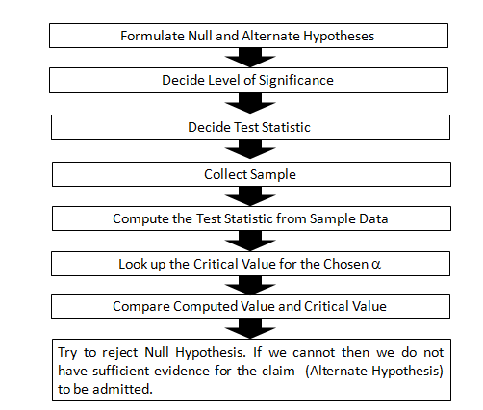
Hypothesis Testing Procedure

Slide 15
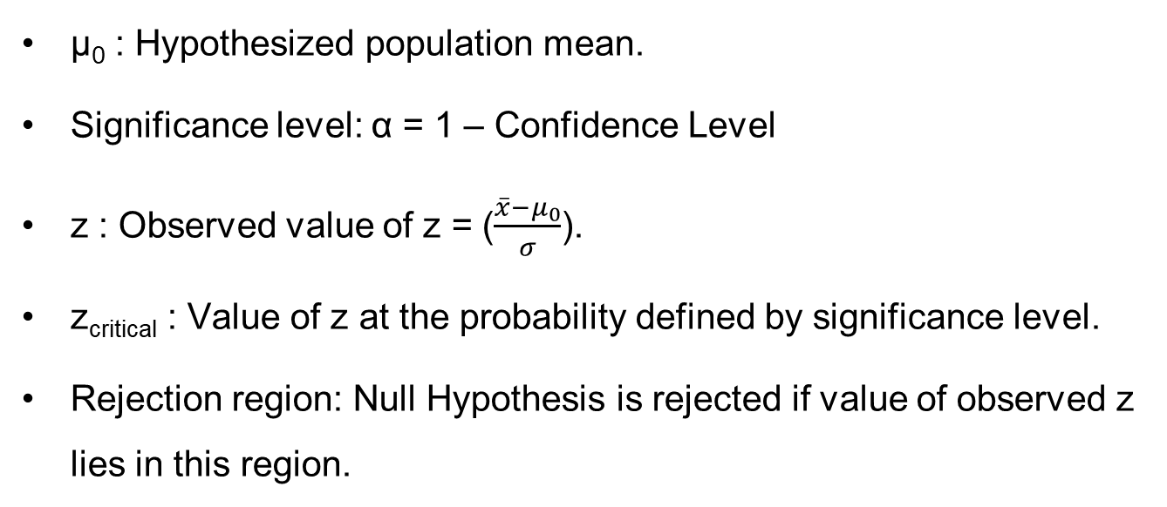
Hypothesis Testing Terminology:
µ₀ : Hypothesized population mean.
Significance level: α = 1 – Confidence Level
z : Observed value of z = ($\frac{\overline{x}−μ_{0}}{σ}$).
z_{critical} : Value of z at the probability defined by significance level.
Rejection region: Null Hypothesis is rejected if value of observed z lies in this region.

Slide 16
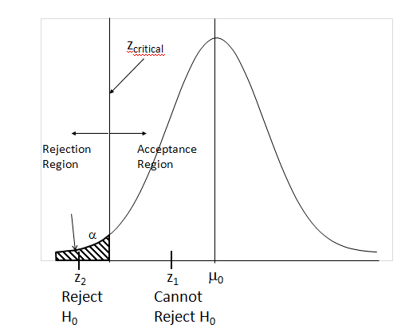
Hypothesis Testing – Identifying Rejection Region

Slide 17
Error
Hypothesis testing involves, collecting a sample and using it to estimate population mean.
It is always possible to land up with an outlier batch (sample) and make wrong estimation of the parameter.
In hypothesis testing, this means we wrongly reject Null Hypothesis since what we have an odd batch which is a rare occurrence (i.e. < 5%).
When this happen, we commit what is called type I error.
If we fix confidence level at 99%, we commit type I error 1% of times.

Slide 18
Type Errors
 |  | Population Condition
 |  | H₀ is True | H₀ is False
Conclusion | Accept H₀ | Correct Conclusion | Type II Error
 | Reject H₀ | Type I Error | Correct Conclusion
Type I Error is referred to as False Positive
Type II Error is referred to as False Negative

Slide 19
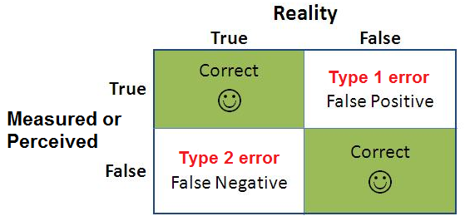
Types of Error
Type I
Type II

Slide 20
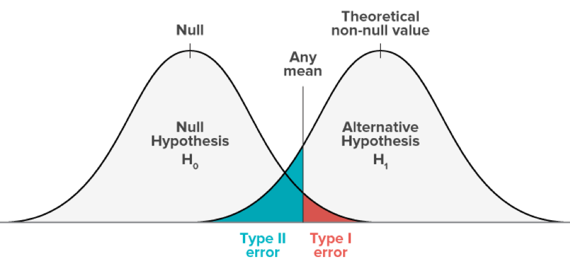
Understanding of Type I error
Type 1 errors are false positives
Happen in hypothesis testing when the null hypothesis is true, but we reject it.
A test with a 95% confidence level means that there is a 5% chance of getting a type 1 error.
Usually in a hypothesis test we only control type 1 error by specifying level of significance α.

Slide 21
Consequences of a Type 1 Error
Means that we wrongfully assume that the hypothesis is true when it is not..
In real life situations this means
Introduction of new technology which is not effective.
Admitting a claim when there is no deficiency of service.
Deploying resources when they are not needed.
Adjusting a process when the process is running fine.

Slide 22
Understanding of Type II error
Type 2 error is referred as False Negative
Type 2 error occurs when the null hypothesis is false, and you fail to reject it.
If the probability of making a type 1 error is denoted by “α”, the probability of a type 2 error is denoted by “β”.
The quantity,1-β is called the power of the test, since it describes the probability of not committing a type 2 error.
There are 3 factors that can affect the power of a test:
Sample size (n)
The significance level of test (α)
The “true” value of your tested parameter.

Slide 23
Number of Tails

Slide 24
One Tailed Test
One tailed tests are used, when it is required to test if observed mean significantly exceeds the hypothesized mean or when it is significantly lesser than the hypothesized mean.
The one-tailed test provides more power to detect an effect in one direction by not testing the effect in the other direction.
Two possibilities:
Right tailed test is when inequality of Alternate Hypothesis points to the right (a > symbol).
Left tailed test is when inequality of Alternate hypothesis statement points to the left(a < symbol).

Slide 25
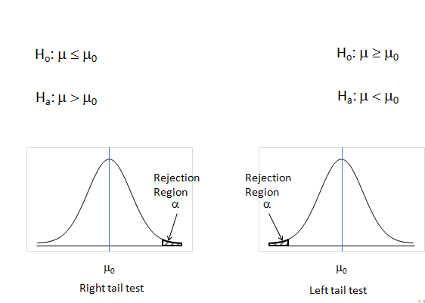
One Tail Tests

Slide 26
Left Tail Test
A consumer forum suspects that 300 gm pack of Narasu’s Coffee, is underweight. The forum wants to check this by collecting a sample and using a 0.05 level of significance.
H_{o}: μ ≥ 300(μ₀)
H_{a}: μ < 300(μ₀)

Slide 27
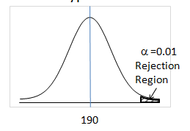
Right Tail Test
The Food Administration Authority received complaints that Maggi Noodle pack contains lead beyond permissible limits. The amount of lead should not exceed 190 gm. Conduct the Hypothesis test.
H_{o}: μ ≤ 190(μ₀)
H_{a}: μ > 190(μ₀)

Slide 28
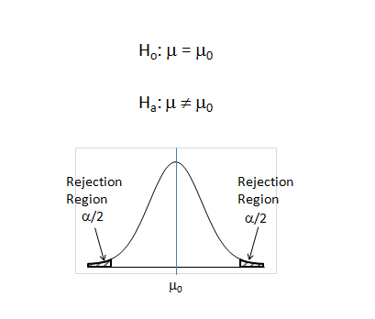
Two Tail Test
Notice that α is split into 2 halves and applied equally on right and left sides. Therefore at the same significance level it is more difficult to reject null hypothesis in a two-tailed test.

Slide 29
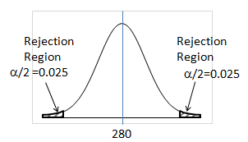
Two Tail Test - Example
The weight of a drug has to be critically controlled. If less, the drug may not be effective, if more it may have some side effects. The manufacturer of the drug wants ascertain that the weight of the capsule is 280 mg at 95% confidence.
H_{o}: μ = 280(μ₀)
H_{a}: μ ≠ 280(μ₀)

Slide 30
Choice of Test Statistic

Slide 31
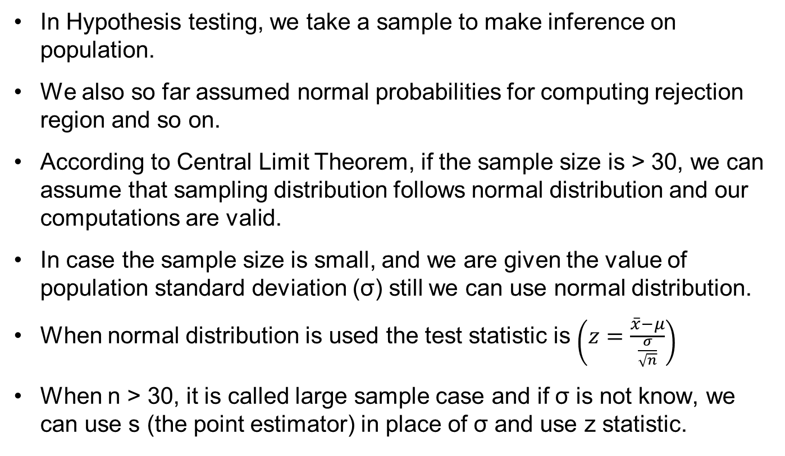
Choice of Test Statistic
In Hypothesis testing, we take a sample to make inference on population.
We also so far assumed normal probabilities for computing rejection region and so on.
According to Central Limit Theorem, if the sample size is > 30, we can assume that sampling distribution follows normal distribution and our computations are valid.
In case the sample size is small, and we are given the value of population standard deviation (σ) still we can use normal distribution.
When normal distribution is used the test statistic is $\left(z=\frac{\overline{x}−μ}{\frac{σ}{\sqrt{n}}}\right)$
When n > 30, it is called large sample case and if σ is not know, we can use s (the point estimator) in place of σ and use z statistic.

Slide 32
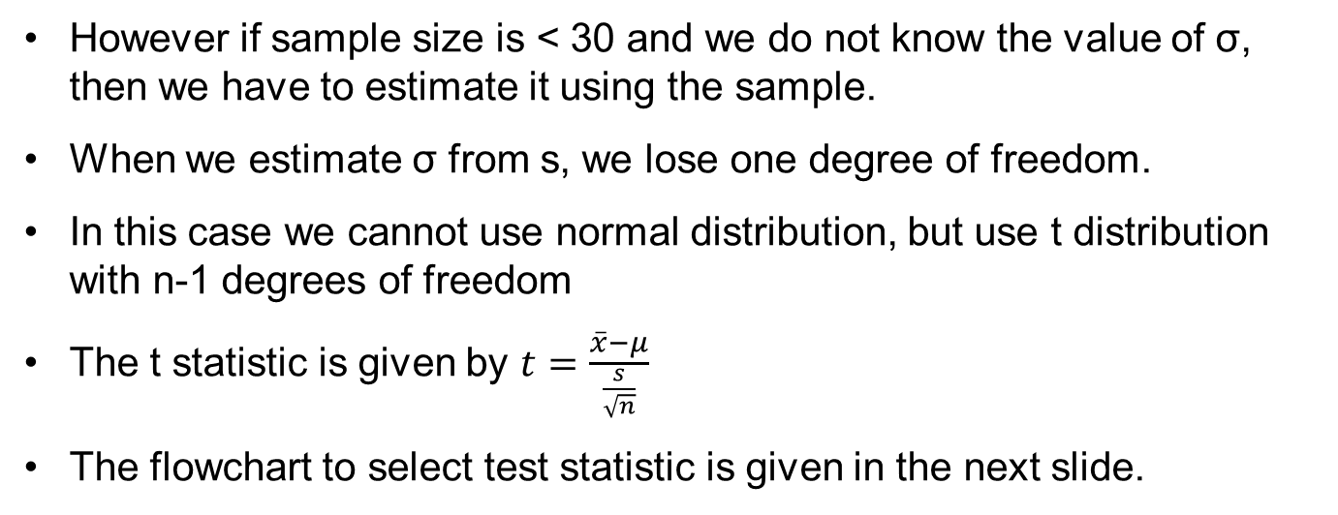
Choice of Test Statistic - Continued
However if sample size is < 30 and we do not know the value of σ, then we have to estimate it using the sample.
When we estimate σ from s, we lose one degree of freedom.
In this case we cannot use normal distribution, but use t distribution with n-1 degrees of freedom
The t statistic is given by $t=\frac{\overline{x}−μ}{\frac{s}{\sqrt{n}}}$
The flowchart to select test statistic is given in the next slide.

Slide 33
Hypothesis Testing Procedure
Is n >= 30?
Yes
No
Is population normal?
Is σ known?
Yes
No
Yes
No
Is σ known?
Yes
No
Use the s to estimate σ
Use the s to estimate σ
Use
Use
Use
Use
Increase sample size to 30

Slide 34
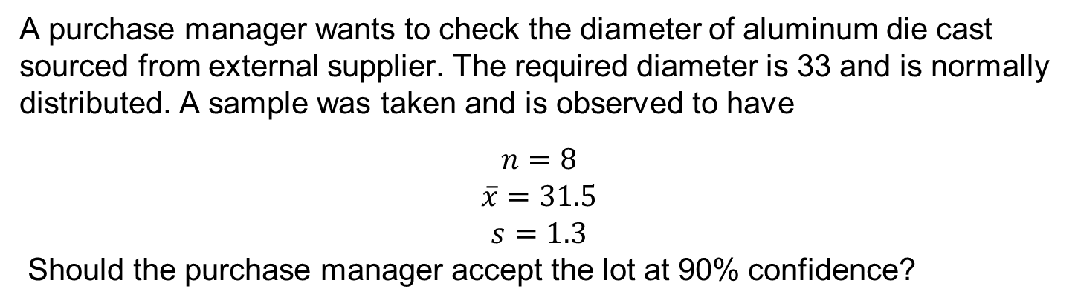
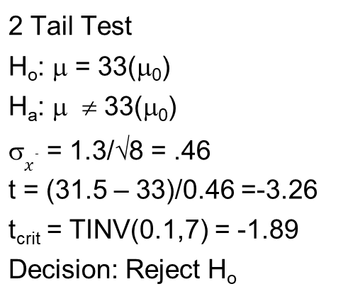
Hypothesis Testing – Small Sample σ Estimated
A purchase manager wants to check the diameter of aluminum die cast sourced from external supplier. The required diameter is 33 and is normally distributed. A sample was taken and is observed to have
$$n=8$$
$$\overline{x}=31.5$$
$$s=1.3$$
Should the purchase manager accept the lot at 90% confidence?
2 Tail Test
H_{o}: μ = 33(μ₀)
H_{a}: μ ≠ 33(μ₀)
σ$\overline{x}$ = 1.3/√8 = .46
t = (31.5 – 33)/0.46 =-3.26
t_{crit} = TINV(0.1,7) = -1.89
Decision: Reject H_{o}

Slide 35
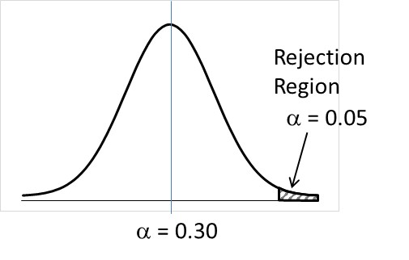
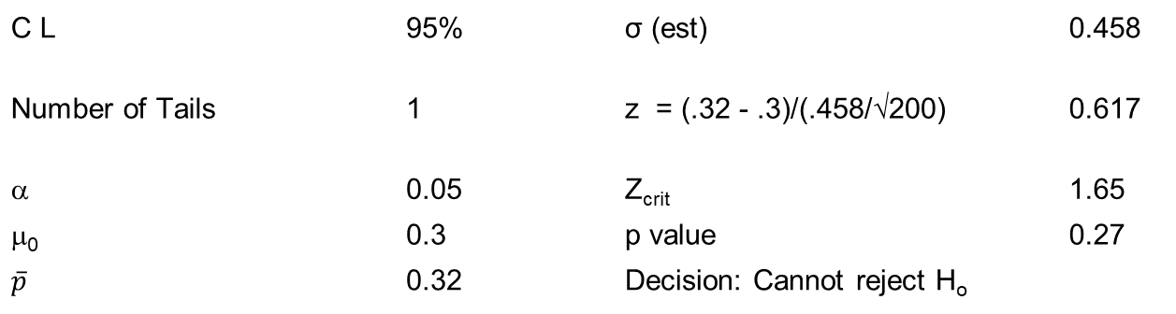
Hypothesis Testing – Proportions
A marketing manager wants to introduce a new product. A blind comparison test is made with a sample size of 200 to assess customer acceptance of the product. The product will be launched only if favorable response is 30% plus. The product found favor with 64 respondents. Should the product be launched?
H_{o}: p ≤ .3 (μ₀)
H_{a}: p > .3 (μ₀)
C L | 95% |  | σ (est) | 0.458
Number of Tails | 1 |  | z = (.32 - .3)/(.458/√200) | 0.617
α | 0.05 |  | Z_{crit} | 1.65
μ₀ | 0.3 |  | p value | 0.27
$$\overline{p}$$ | 0.32 |  | Decision: Cannot reject H_{o}

Slide 36
Hypothesis Tests involving Two Populations

Slide 37
One-Sample, Two-Sample and Paired Sample tests
One Sample test | It is a statistical procedure used to determine whether a sample of observations could have been generated by a process with a specific mean.
Two Sample test | It is applied to compare whether the average difference between two groups (independent samples) is significant.
Paired Sample test | It is used to compare two population means where you have two samples in which observations in one sample can be paired with observations in the other sample.

Slide 38
One Sample – Z test

Slide 39
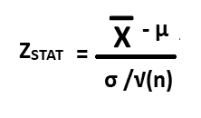
One-Sample test
Z test for Mean (σ known)
where X- is the mean of the sample
µ is the mean of the population
σ is the standard deviation of the population
n is the number of observations

Slide 40
One-Sample test - Z test for Mean (σ known)
A Pizza restaurant claims that the average delivery time of pizza is 20 minutes with the Standard deviation of 12 minutes. A sample of 30 pizza delivery times is given below:
38, 38, 10, 10, 10, 10, 10, 38, 10, 38, 10, 10, 10, 10, 10, 38, 10, 38, 10, 38, 38, 38, 10, 38, 38, 38, 38, 10, 10, 38
Test whether there is a significant deviation between your sample mean and the population mean?
Solution
We observe from the sample, sample mean = 692 / 30 = 23.07
n = 30
µ = 20 and σ = 12

Slide 41
One-Sample test - Z test for Mean (σ known)
Step 1: State the null and alternative hypothesis
H0: µ ≤ 20 minutes
HA: µ > 20 minutes
Step 2: Choose the level of significance, α to be 5% and sample size is 30
Step 3: Choose the appropriate test statistic. Since σ is known, you use the normal distribution and ZSTAT as test statistic.
Step 4: Determine the critical value that divides the rejection and non-region regions.
Critical values are selected so that the rejection region contains a total area of α when H0 is true and the non-rejection region contains a total area of 1 - α when H0 is true. Since α = 0.05, the critical value of ZSTAT is 1.65.

Slide 42
One-Sample test - Z test for Mean (σ known)
Critical value
Step 5: Collect the data, organize the results and compute the value of the test statistic.
Z = (23.07 - 20) / (12 / sqrt(30)) = 1.40
Step 6: State the statistical decision and the managerial conclusion.
Z_{STAT} is in the region of rejection because Z_{STAT} < Z_{CRITICAL} (=1.65) where Z_{STAT} = 1.40
Because the test statistic falls in the non-rejection region, the statistical decision is to accept the null hypothesis.
The managerial conclusion is that insufficient evidence exists to prove that pizza delivery time is different from the claimed delivery time of 20 minutes. No Corrective action on delivery process is required.

Slide 43
One-Sample test - Z test for Mean (σ known)
P value approach
Step 5: Collect the data, organize the results and compute the p value of the test statistic.
Z = (23.07 - 20) / (12 / sqrt(30)) = 1.40
P(X > Z = 1.40) = 1 – 0.9192 = 0.0808
Step 6: State the statistical decision and the managerial conclusion.
Since P-value (0.0808) > 0.05 (our level of significance), we accept null hypothesis.
So statistical decision is to accept the null hypothesis.
The managerial conclusion is that insufficient evidence exists to prove that pizza delivery time is different from the claimed delivery time of 20 minutes. No Corrective action on delivery process is required.

Slide 44
One Sample – t test

Slide 45
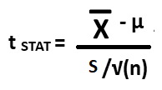
One Sample - t test for Mean (σ unknown)
where is the mean of the sample
µ is the mean of the population
s is the Sample standard deviation
n is the number of observations
Here, t follows a t distribution having n-1 degrees of freedom

Slide 46
One-Sample test - t test for Mean (σ unknown)
Example: Consider amount from Sales invoice of a nearby restaurant given the population mean is 120 USD.
108.98, 152.22, 111,45, 110.59, 127.46, 107.26, 93.32, 91.97, 111.56, 75.71, 128.58, 135.11
Test whether there is a significant deviation between your sample mean and the population mean?
Solution:
We observe from the sample,
Sample mean = 1354.21 / 12 = 112.85
Sample Std. deviation = 20.80
n = 12
µ = 120
s = 20.80

Slide 47
One-Sample test - t test for Mean (σ unknown)
Step 1: State the null and alternative hypothesis
H0: µ = 120
HA: µ ≠ 120
Step 2: Choose the level of significance, α to be 5% and sample size is 12
Step 3: Choose the appropriate test statistic. Since σ is unknown, you use the t distribution and t_{STAT} as test statistic.
Step 4: Determine the critical value that divides the rejection and non-region regions.
For a given sample size n, the test statistic follows a t distribution with n-1 degrees of freedom. The alternative hypothesis has inequality sign and therefore has two tails. The area of rejection of the t distribution's left (lower) tail is 0.025, and the area in the rejection region of the t distribution's right (upper) tail is also 0.025. The t critical values are (-2.201 and 2.201) for 11 degrees of freedom at 5 % level of significance.

Slide 48
One-Sample test - t test for Mean (σ unknown)
Using Critical Value approach
Step 5: Collect the data, organize the results and compute the value of the test statistic.
t = (112.85 - 120) / (20.80 / sqrt(12)) = -1.191
Step 6: State the statistical decision and the managerial conclusion.
t is not in the region of rejection because t_{STAT} < t_{CRITICAL} (-2.201) where t = - 1.191 Because the test statistic falls in the non-rejection region, the statistical decision is not to reject the null hypothesis.
The managerial conclusion is that insufficient evidence exists to prove that mean amount per invoice has changed.
No Corrective action on sales process is required.

Slide 49
One-Sample test - t test for Mean (σ unknown)
P value approach
Step 5: Collect the data, organize the results and compute the p value of the test statistic.
t = (112.85 - 120) / (20.80 / sqrt(12)) = -1.1908
P(X > t = -1.1908, 11 df) = 0.259
Step 6: State the statistical decision and the managerial conclusion.
Since P-value (=0.259) > 0.05 (our level of significance), we do not reject null hypothesis. So statistical decision is not to reject the null hypothesis.
The managerial conclusion is that insufficient evidence exists to prove tha mean amount per invoice has not changed.
No Corrective action on sales process is required.

Slide 50
Two Sample Test

Slide 51
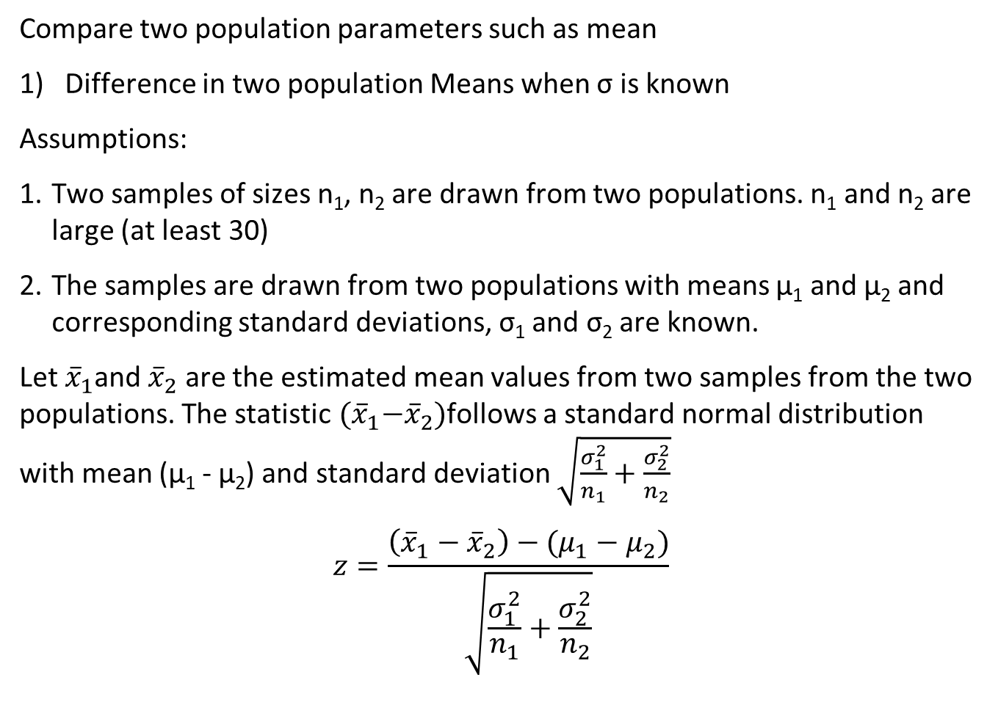
Two Sample Test
Compare two population parameters such as mean
1) Difference in two population Means when σ is known
Assumptions:
Two samples of sizes n₁, n₂ are drawn from two populations. n₁ and n₂ are large (at least 30)
The samples are drawn from two populations with means µ₁ and µ₂ and corresponding standard deviations, σ₁ and σ₂ are known.
Let ${\overline{x}}_{1}$and ${\overline{x}}_{2}$ are the estimated mean values from two samples from the two populations. The statistic ${(\overline{x}}_{1}−{\overline{x}}_{2})$follows a standard normal distribution with mean (µ₁ - µ₂) and standard deviation $\sqrt{\frac{σ_{1}^{2}}{n_{1}}+\frac{σ_{2}^{2}}{n_{2}}}$
$$z=\frac{\left({\overline{x}}_{1}−{\overline{x}}_{2}\right)−(μ_{1}−μ_{2})}{\sqrt{\frac{σ_{1}^{2}}{n_{1}}+\frac{σ_{2}^{2}}{n_{2}}}}$$

Slide 52
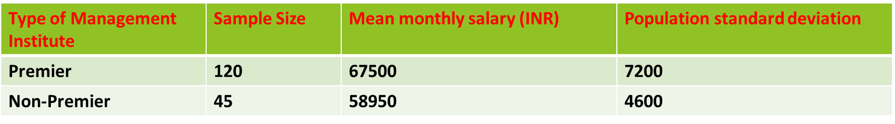
Two-Sample test - Z test for Mean (σ known)
Example: Salary of Management trainees with MBA from Premier institute and other institutes are given below:
Assume that the salary of Management trainees with MBA from Premier and non-Premier institutes follow normal distribution.
Check whether the difference in monthly salary is at least 5000 or more for Management trainees with MBA from Premier Institutes.

Slide 53

Two-Sample test - Z test for Mean (σ known)
Solution
We observe from the data,
n1 = 120 and n2 = 45
σ₁ = 7200; σ2 = 4600
Step 1: State the null and alternative hypothesis
H₀: µ1 - µ2 ≤ 5000
H_{a}: µ1 - µ2 > 5000
Step 2: Choose the level of significance, α to be 5%.
Step 3: Choose the appropriate test statistic. Since σ is known, you use the Z distribution and Z as test statistic.

Slide 54
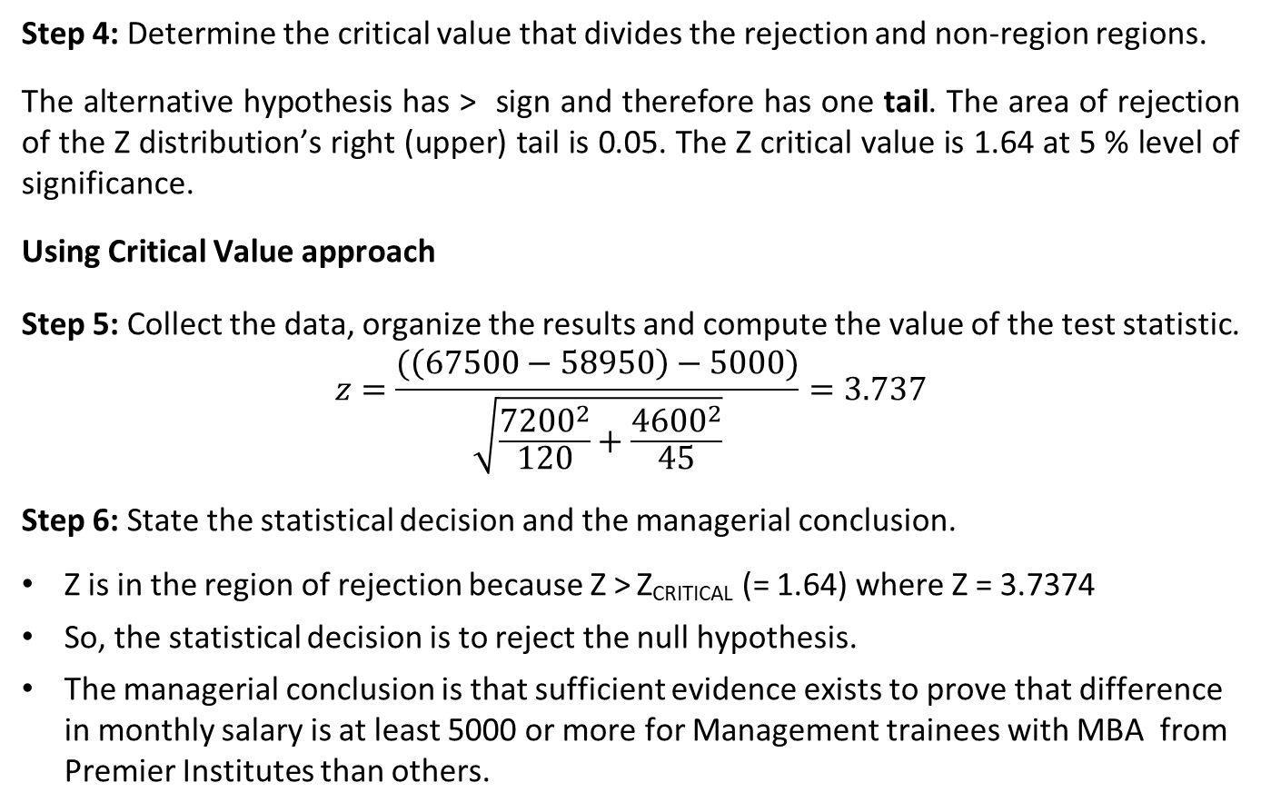
Two-Sample test - Z test for Mean (σ known)
Step 4: Determine the critical value that divides the rejection and non-region regions.
The alternative hypothesis has > sign and therefore has one tail. The area of rejection of the Z distribution’s right (upper) tail is 0.05. The Z critical value is 1.64 at 5 % level of significance.
Using Critical Value approach
Step 5: Collect the data, organize the results and compute the value of the test statistic.
$$z=\frac{(\left(67500−58950\right)−5000)}{\sqrt{\frac{{7200}^{2}}{120}+\frac{{4600}^{2}}{45}}}=3.737$$
Step 6: State the statistical decision and the managerial conclusion.
Z is in the region of rejection because Z > Z_{CRITICAL} (= 1.64) where Z = 3.7374
So, the statistical decision is to reject the null hypothesis.
The managerial conclusion is that sufficient evidence exists to prove that difference in monthly salary is at least 5000 or more for Management trainees with MBA from Premier Institutes than others.

Slide 55
Two-Sample test - Z test for Mean (σ known)
Step 4: Determine the critical value that divides the rejection and non-region regions.
The alternative hypothesis has > sign and therefore has one tail. The area of rejection of the Z distribution’s right (upper) tail is 0.05. The Z critical value is 1.64 at 5 % level of significance.
P Value approach
Step 5: Collect the data, organize the results and compute the value of the test statistic.
P-value = 9.296022e-05
Step 6: State the statistical decision and the managerial conclusion.
Since P-value (= 9.296022e-05) < 0.05 (our level of significance), we reject null hypothesis.
The managerial conclusion is that sufficient evidence exists to prove that difference in monthly salary is at least 5000 or more for Management trainees with MBA from Premier Institutes than others.

Slide 56
Matched/Paired Sample Hypothesis Test
Compare a population parameter such as mean before and after intervention.
In a paired t test, the data related to a parameter is captured twice, once before the intervention and once after the intervention. (Example: Amount of alcohol consumed by people before and after marriage break-up)
Assumptions:
The differences between the estimated parameter before and after intervention follow a normal distribution.
Test statistic, t = (D - µ_{D}) / (S_{D} / √(n)) follows a t distribution with n -1 degrees of freedom.
Here D is the mean difference in the estimated parameter values before and after the treatment
µ_{D} is the hypothesized mean difference and S_{D} is the corresponding standard deviation.

Slide 57
Example of Paired Sample t Test
A researcher believes that Cholesterol level of participants of a meditation program will be lesser after completing the program than before attending the program. Check the claim at 5% level of significance.
Sample size = 50, D = 14 S_{D} = 8.5 µ_{D} = 10 mg/dL
Solution:
Step 1: State the null and alternative hypothesis
H0: µ_{D} ≤ 10
HA: µ_{D} > 10
Step 2: Choose the level of significance, α to be 5% and sample size is 50
Step 3: Choose the appropriate test statistic. Since σ is unknown, you use the t distribution and t as test statistic.

Slide 58
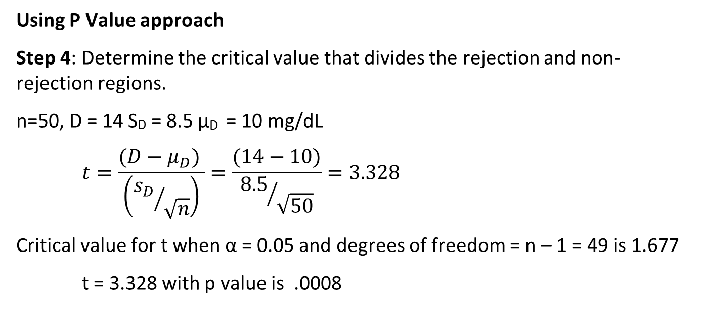
Paired Sample t Test
Using P Value approach
Step 4: Determine the critical value that divides the rejection and non-rejection regions.
n=50, D = 14 S_{D} = 8.5 µ_{D} = 10 mg/dL
$$t=\frac{(D−μ_{D}) }{\left({s_{D}}/{\sqrt{n}}\right)}=\frac{(14−10)}{{8.5}/{\sqrt{50}}}=3.328$$
Critical value for t when α = 0.05 and degrees of freedom = n – 1 = 49 is 1.677
t = 3.328 with p value is .0008

Slide 59
Paired Two-Sample t test
Step 6: State the statistical decision and the managerial conclusion.
t is in the region of rejection because p value (= 0.0008) < 0.05
So, the statistical decision is to reject the null hypothesis.
The managerial decision is that sufficient evidence exists to prove that cholesterol level of participants of meditation program reduces at least by 10 mg/dL after attending the meditation program at 5% level of significance.

Slide 60
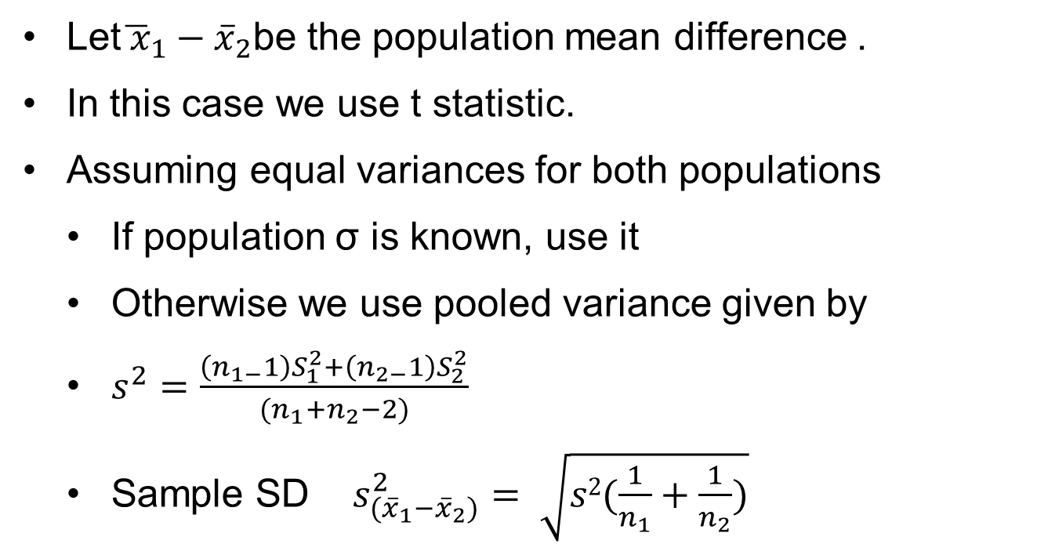
Testing for Mean Difference of Two Population
Independent Samples – Small Sample Case
Let${\overline{ x}}_{1}{− \overline{x}}_{2}$be the population mean difference .
In this case we use t statistic.
Assuming equal variances for both populations
If population σ is known, use it
Otherwise we use pooled variance given by
$s^{2}=\frac{\left(n_{1−}1\right)S_{1}^{2}+\left(n_{2−}1\right)S_{2}^{2}}{(n_{1}+n_{2}−2)}$
Sample SD $s_{({\overline{x}}_{1}−{\overline{x}}_{2})}^{2}= \sqrt{s2(\frac{1}{n_{1}}+\frac{1}{n_{2}})}$

Slide 61
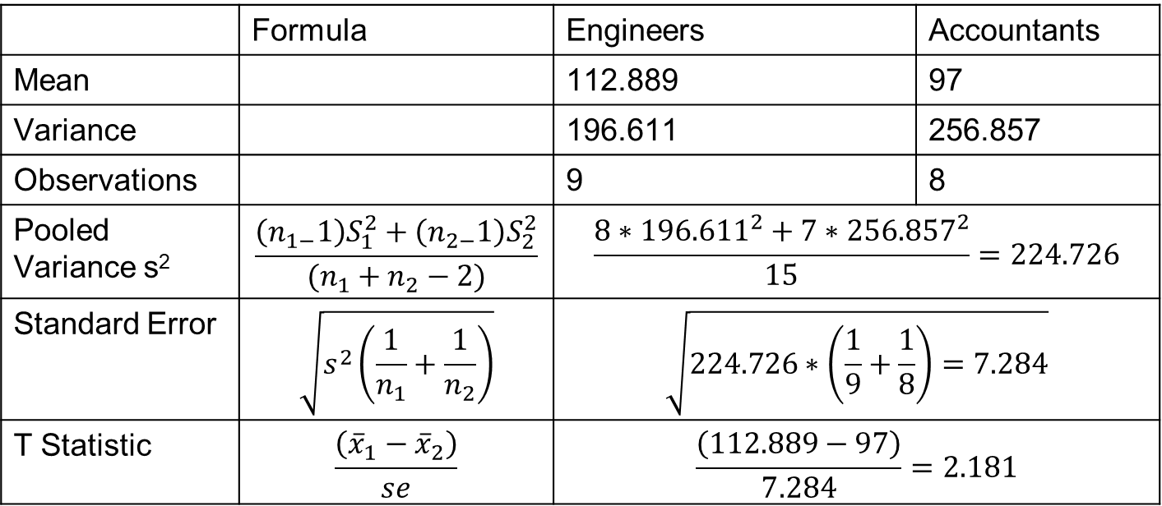
Independent Sample t Test
An aptitude test was conducted in which groups of engineering and accounting executives participated. Is there a significant difference in the performance the groups?
Scores
Engineers | 125 | 115 | 119 | 85 | 97 | 107 | 125 | 125 | 118
Accountants | 112 | 98 | 109 | 96 | 77 | 70 | 114 | 100
 | Formula | Engineers | Accountants
Mean |  | 112.889 | 97
Variance |  | 196.611 | 256.857
Observations |  | 9 | 8
Pooled Variance s² | $$\frac{\left(n_{1−}1\right)S_{1}^{2}+\left(n_{2−}1\right)S_{2}^{2}}{(n_{1}+n_{2}−2)}$$ | $$\frac{8∗{196.611}^{2}+7∗{256.857}^{2}}{15}=224.726$$
Standard Error | $$\sqrt{s^{2}\left(\frac{1}{n_{1}}+\frac{1}{n_{2}}\right)}$$ | $$\sqrt{224.726∗\left(\frac{1}{9}+\frac{1}{8}\right)=7.284}$$
T Statistic | $$\frac{\left({\overline{x}}_{1}−{\overline{x}}_{2}\right)}{se}$$ | $$\frac{\left(112.889−97\right)}{7.284}=2.181$$

Slide 62
Independent Sample t Test
Solution:
t-Test: Two-Sample Assuming Equal Variances
 | Engineers | Accountants
Mean | 112.889 | 97
Variance | 196.611 | 256.857
Observations | 9 | 8
Pooled Variance | 224.726
Hypothesized Mean Difference | 0
df | 15
t Stat | 2.181
P(T<=t) one-tail | 0.023
t Critical one-tail | 1.753
P(T<=t) two-tail | 0.045
t Critical two-tail | 2.131
This is a 2 Tail Test. Since positive t > t_{critical}, we reject null hypothesis. There is significant difference is performance.

Slide 63
Hypothesis Testing Under Decision Making Situation
The NULL (H₀) and ALTENATE (H_{a}) hypotheses are competing statements.
Only one of them can be true but not both.
An ideal testing procedure should lead to acceptance of H_{o} when it is true and rejection when false.
Unfortunately, there is always an error in estimating true location of population mean and therefore we may not arrive at correct conclusion every time.
The table below shows what can happen in making decisions based on a hypothesis test.

Slide 64
Type Errors
 |  | Population Condition
 |  | H₀ is True | H₀ is False
Conclusion | Accept H₀ | Correct Conclusion | Type II Error
 | Reject H₀ | Type I Error | Correct Conclusion

Slide 65
Type I Error
Table showed that two kinds of error can be made
Incorrectly rejecting H₀ when it is true, is called type I error
Incorrectly accepting H₀ when it is false, is called type II error.
Type I error corresponds to admitting the claim when it reality it is wrong.
In practice the analyst tries to control the probability of this error by specifying confidence coefficient α.
Let 10 criminals escape but one innocent should not be punished.
Smaller the value of α more difficult it is to reject H₀ and less is the chance of committing type I error.
Therefore we have a high degree of confidence in stating that the claim is true when we select a low value for α.
The action required to process the claim is justified.

Slide 66
Type II Error
In the foregoing argument, we implicitly assumed that we can ignore the consequence of committing the other type of error that is accepting H₀ when it is false.
In judicial system it is stated that “Let nine criminals escape but one innocent should not get punished”.
This is the same system we adopt in hypothesis testing that we are willing to control type I error while ignoring the magnitude of type II error.
In hypothesis testing parlance type I error is designated as α and type II error as β.
We can encounter situations where committing either type of error results in consequences that require management action. The following scenario illustrates this situation.

Slide 67

Business Case
A UPS manufacturer procures battery units from outside supplier for incorporating into his product. The inward quality control department carries out checks for quality before accepting the lot. Rejected lots are sent back resulting in shipping costs and possible effect on supplier relation if done frequently. On the other hand if a poor quality lot is accepted the end product’s quality will be affected resulting warranty claims, customer dissatisfaction and after-sales service load.
H_{o}: μ ≥ 120 H_{a}: μ < 120 | CL = 95% | α=0.05 | n = 36 | s = 12
We can calculate $\overline{x}$ at Z_{critical} above which the lot will be accepted.
$\overline{x}≥$ 120-1.645(12/$\sqrt{36)}=116.71$

Slide 68
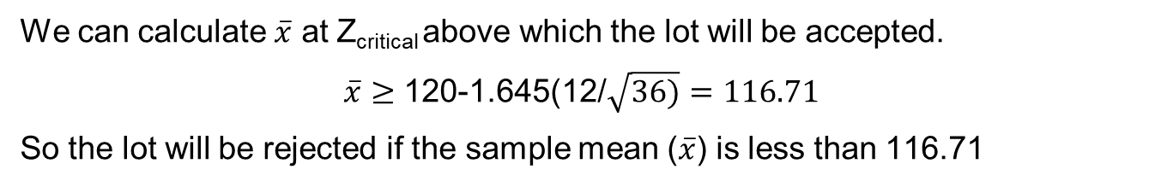
Calculating Type II Error Probability
A UPS manufacturer uses 120Ah battery in the production of UPS. He battery is sourced from a supplier. A batch of 36 batteries is tested and accepted at 95% confidence level.
To evaluate quality of incoming lot the company has set up a following inspection scheme. Design specifications require that acceptable capacity of the battery is 120Ah. The company formulated the following hypothesis test.
H_{o}: μ ≥ 120 H_{a}: μ < 120 | CL = 95% | α=0.05 | n = 36 | s = 12
We can calculate $\overline{x}$ at Z_{critical} above which the lot will be accepted.
$\overline{x}≥$ 120-1.645(12/$\sqrt{36)}=116.71$
So the lot will be rejected if the sample mean ($\overline{x}$) is less than 116.71

Slide 69
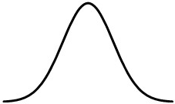

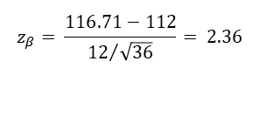

Probability of making type II error
Type II error is committed whenever we accept null hypothesis when it is in fact false.
For the case in hand a type II error is committed whenever μ < 120.
Probability of committing type II error is designated by β.
Let us calculate value of β when μ = say 112.
$$σ_{\overline{x}}=12/\sqrt{36}=2$$
$$z_{β}= \frac{116.71−112}{{12}/{\sqrt{36}}}= 2.36$$
β=.0093
$${2.36 σ}_{\overline{x}}$$
μ = 112

Slide 70
Probability of making type II error
From the above, when true μ is 112, the probability of making type II error is only 0.0093. The same way we can calculate β for various values of μ ranging from 112 to 120. This is shown in the table below:
μ | z | β | (1-β)
112 | 2.355 | .0093 | .9907
113 | 1.855 | .0318 | .9682
114 | 1.355 | .0877 | .9123
115 | 0.855 | .1963 | .8037
116 | 0.355 | .3613 | .6387
117 | -0.145 | .5576 | .4424
118 | -0.645 | .7405 | .2595
119 | -1.145 | .8739 | .1261
120 | -1.645 | .9500 | .0500

Slide 71
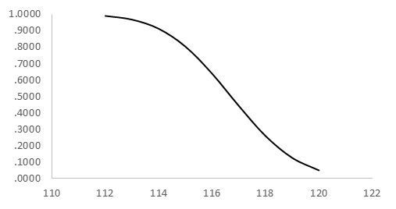
Probability of making type II error
Where μ is true population mean, β is probability of type II error and (1-β) is the probability of correctly rejecting null hypothesis and is called power of the test. The following graph which plots (1-β) at various values of μ is called power curve.
The power curve extends over the region where H₀ is false. The height of the curse indicates probability of correctly rejecting null hypothesis when it is false. As μ approaches hypothesized mean μ₀ the probability falls. In other words the probability of type II error increase as μ approaches μ₀.
POWER CURVE
Probability of correctly rejecting H₀
μ
H₀ False

Slide 72


Controlling type II error
Consider the following diagram which is a continuation of hypothesis test described above. In the one tail test discussed above the null and alternate hypotheses were of the type
H₀: μ ≥ μ₀
H_{a}: μ < μ₀
Sampling distribution of $\overline{x}$ when H₀ is true i.e.μ=μ₀
Reject H₀
α
μ₀
Sampling distribution of $\overline{x}$ when H₀ is false i.e.μ=μ_{a}
β
μ_{a}
c

Slide 73
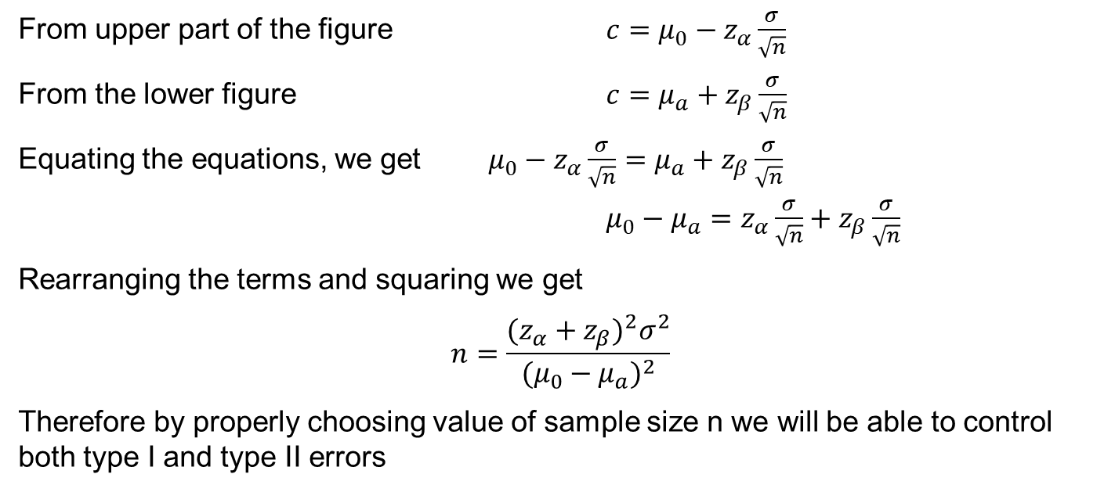
Controlling type II error
From upper part of the figure $c=μ_{0}−z_{α}\frac{σ}{\sqrt{n}}$
From the lower figure $c=μ_{a}+z_{β}\frac{σ}{\sqrt{n}}$
Equating the equations, we get $μ_{0}−z_{α}\frac{σ}{\sqrt{n}}=μ_{a}+z_{β}\frac{σ}{\sqrt{n}}$
$μ_{0}−μ_{a}=z_{α}\frac{σ}{\sqrt{n}}+z_{β}\frac{σ}{\sqrt{n}}$
Rearranging the terms and squaring we get
$$n=\frac{{(z_{α}+z_{β})}^{2}σ^{2}}{{(μ_{0}−μ_{a})}^{2}}$$
Therefore by properly choosing value of sample size n we will be able to control both type I and type II errors

Slide 74
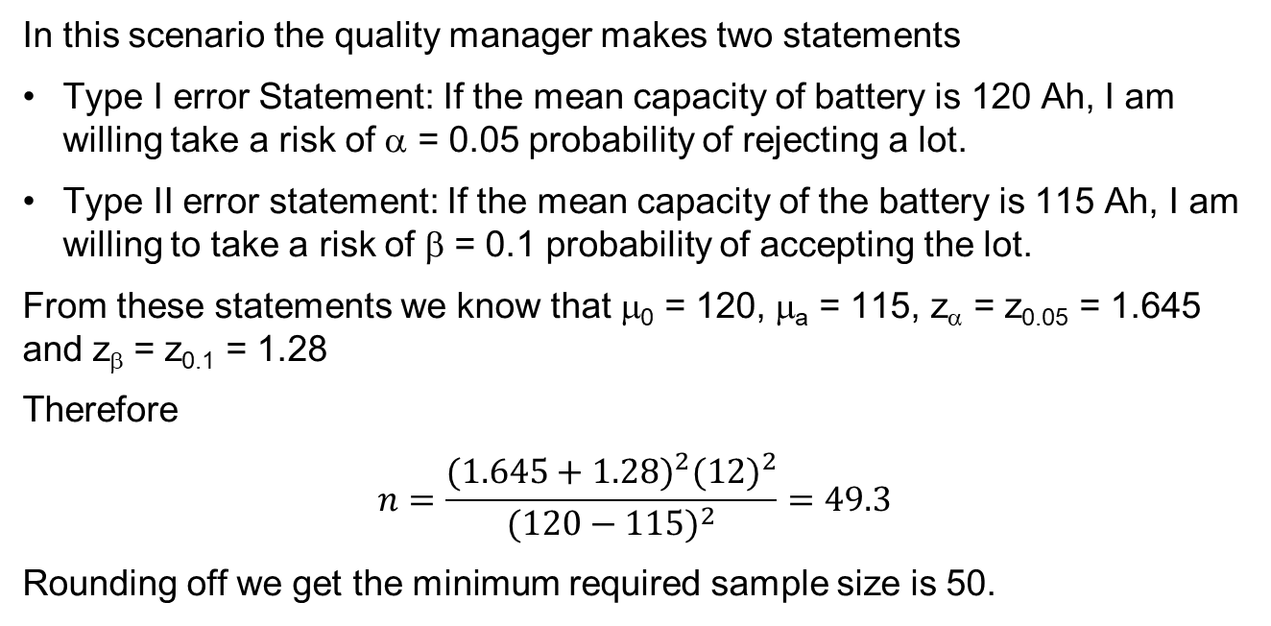
Illustration
In this scenario the quality manager makes two statements
Type I error Statement: If the mean capacity of battery is 120 Ah, I am willing take a risk of α = 0.05 probability of rejecting a lot.
Type II error statement: If the mean capacity of the battery is 115 Ah, I am willing to take a risk of β = 0.1 probability of accepting the lot.
From these statements we know that μ₀ = 120, μ_{a} = 115, z_{α} = z_{0.05} = 1.645 and z_{β} = z_{0.1} = 1.28
Therefore
$$n=\frac{{(1.645+1.28)}^{2}{(12)}^{2}}{{(120−115)}^{2}}=49.3$$
Rounding off we get the minimum required sample size is 50.

